Slide 1
PRESENTATION WEB API
A RESTful API for Online Movie Service
Abraham Alabi – x17342373 Jegan Francis Mendy – x18131212 Tijesu Olalekan – x17347773 Ting Chang – x16370076

Slide 2
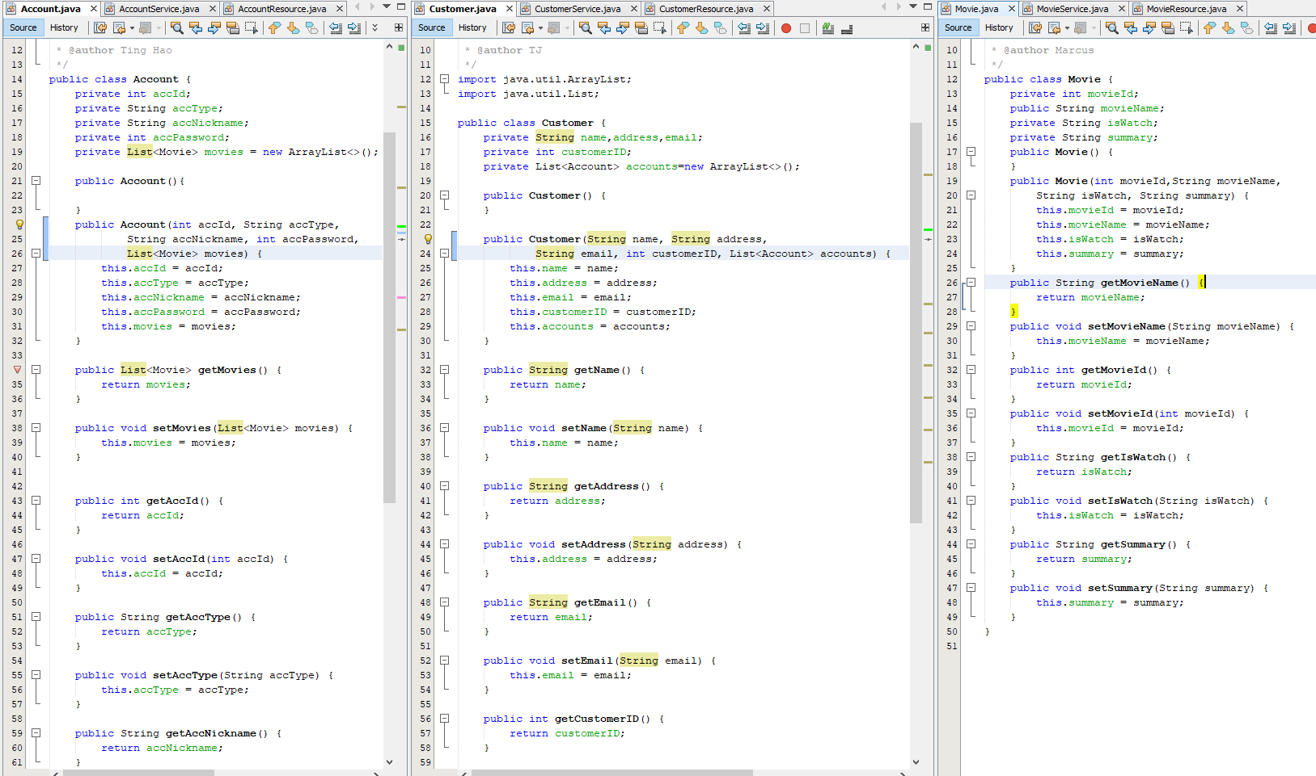
MODELS

Slide 3
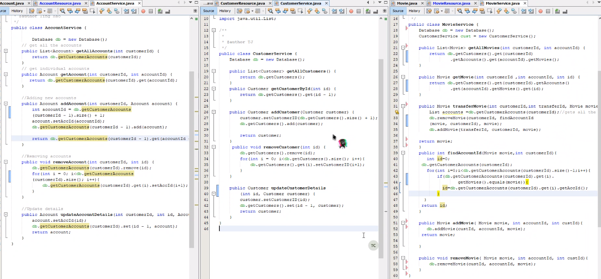
SERVICES

Slide 4
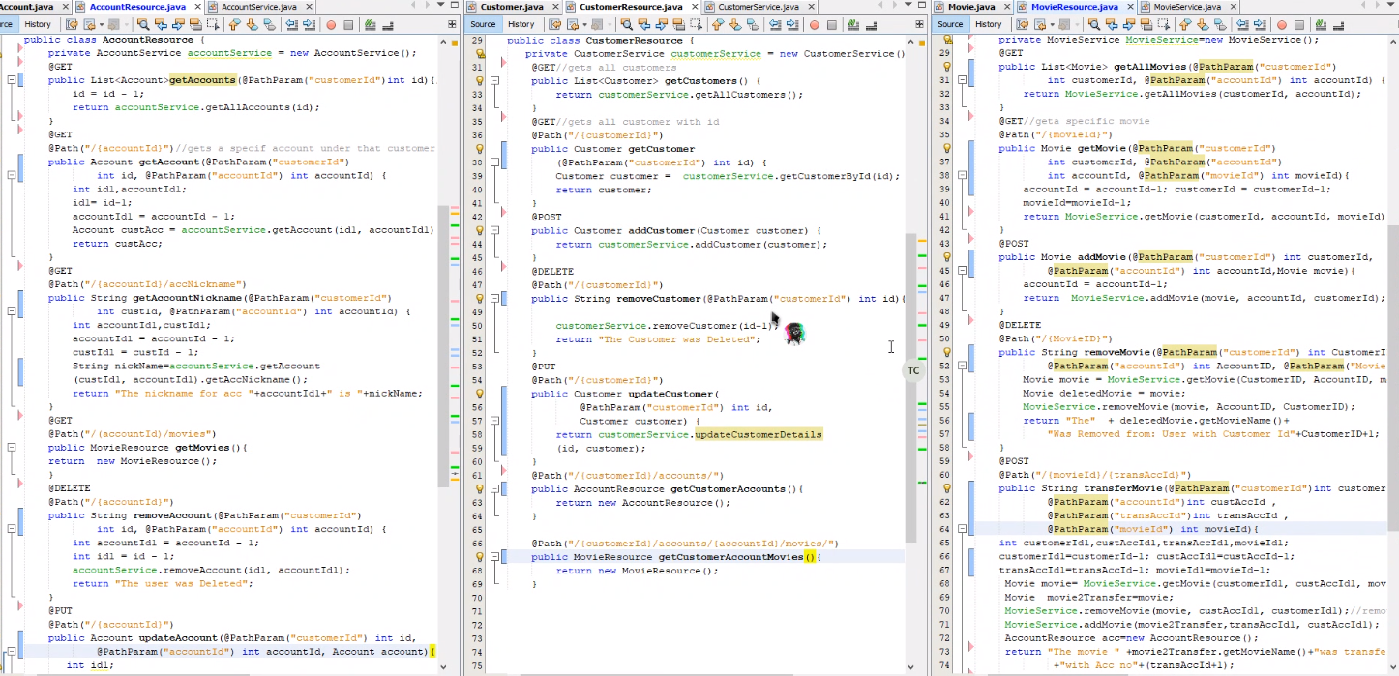
RESOURCES

Slide 5
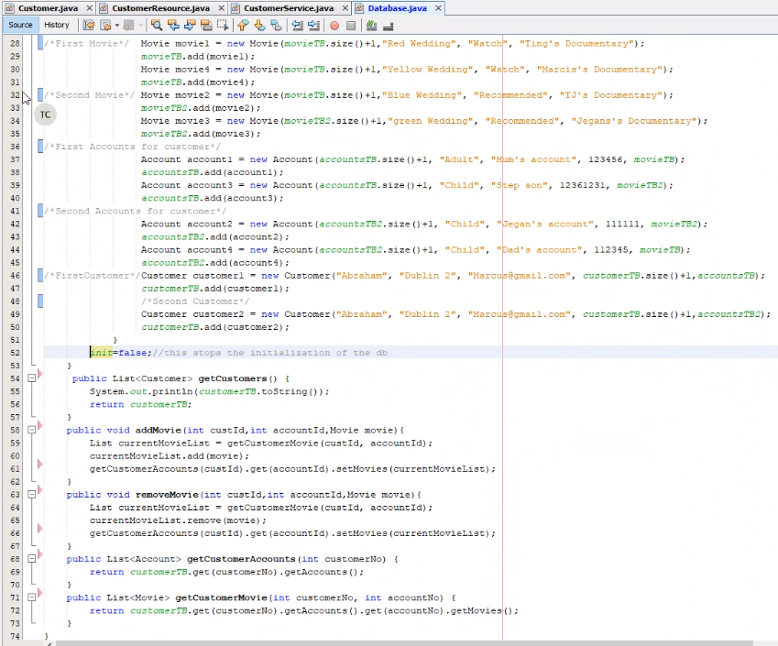
Database

Slide 6
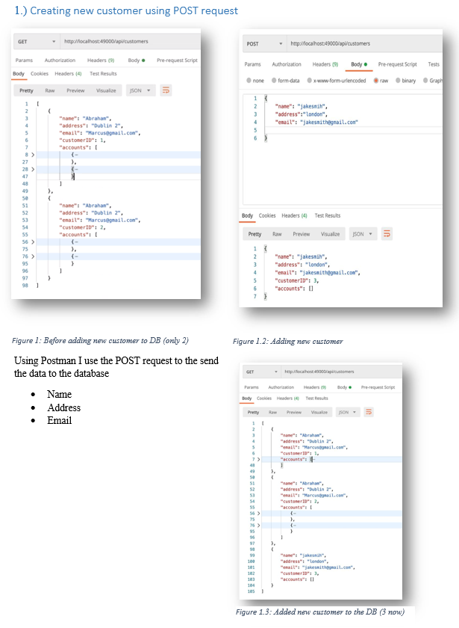
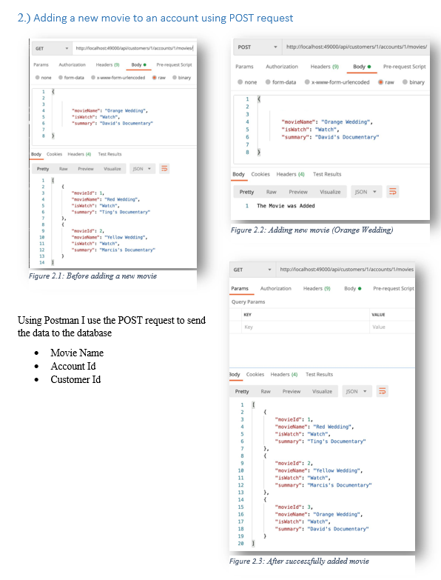
API POSTMAN

Slide 7
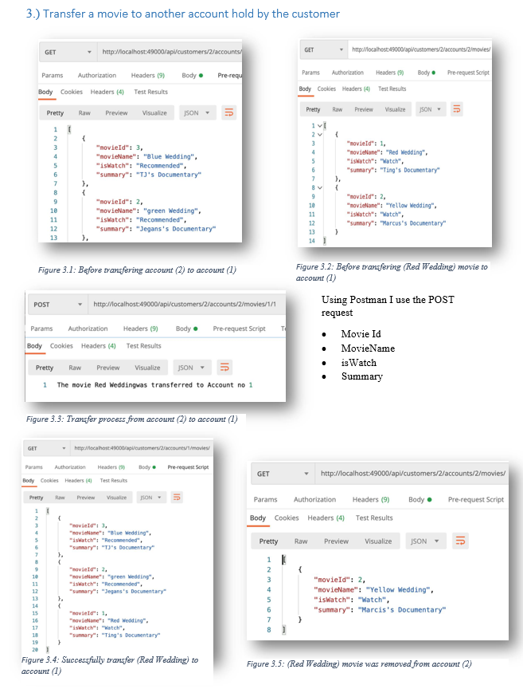
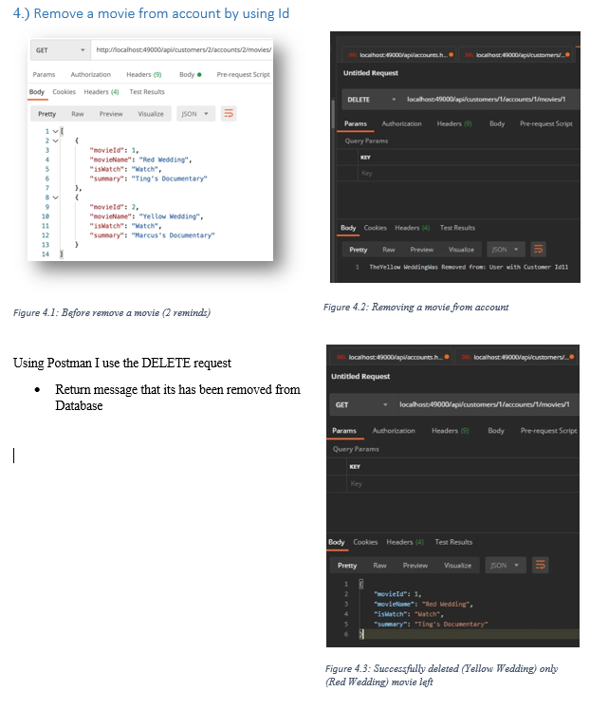
API POSTMAN

Slide 8
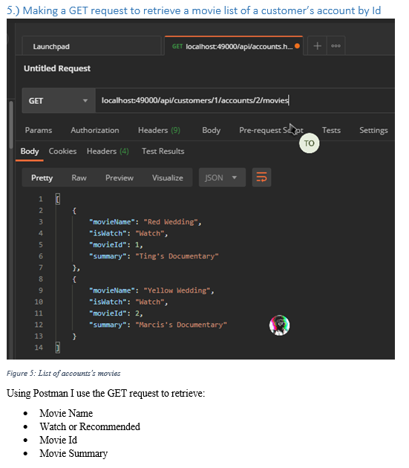
API POSTMAN

